Slide 2
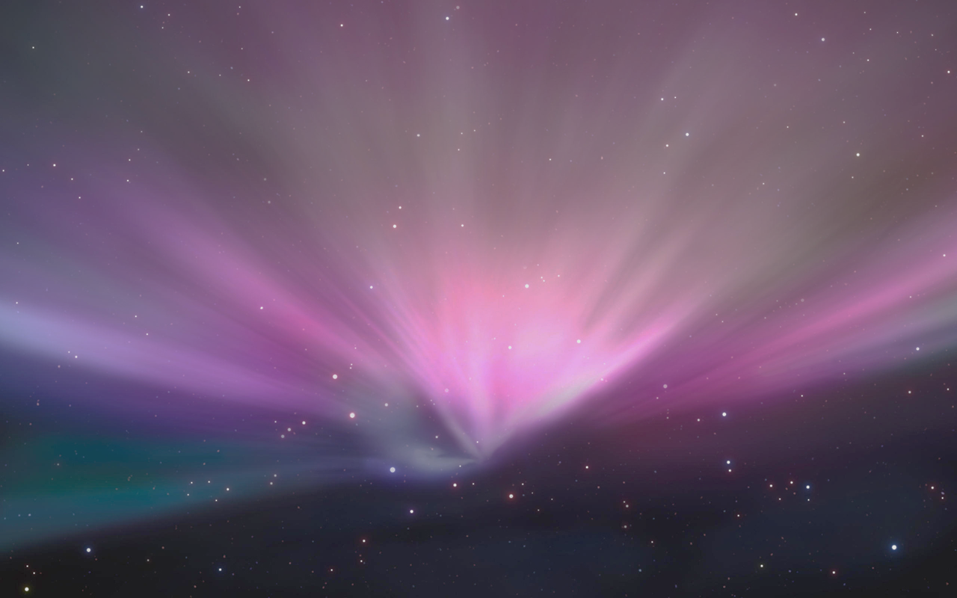

Pear New Product Launch
2016
Notes:
Thank you and welcome to Pear’s New Product Launch. It’s great to have the media and all the big news outlets here today, reporting on our new launch. I’m confident you will like what we have to share.
First I’d like to introduce myself, I’m Vanessa Grass, Chief Data Science Evangelist at Pear. Over last decade at Pear, we as a company have become more data focused, leveraging the power of machine learning and modeling to better drive our decision making process. Today I’d like to walk you through how we used data over the past 10 years to better help inform our new product launch. Joining me here today are my colleagues from the data team — JC Balakrishnan, Chief Data Officer, and Gavin Soong, VP of Data Science. We have some very exciting announcements to share with you about what we have been hard at work on at Pear.

Slide 3
Introducing the uPhone 10
Notes:
Today I’m very excited to share with you the uPhone 10. We have spent the last year perfecting countless prototypes and we finally arrived at a delightful new mobile phone experience.

Slide 4
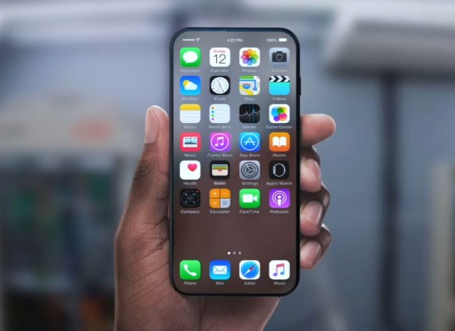
Notes:
As you can see, there are several major design changes that I will let our product design team discuss later in today's event. What I’d like to share with you now is our data driven approach to this launch.

Slide 5
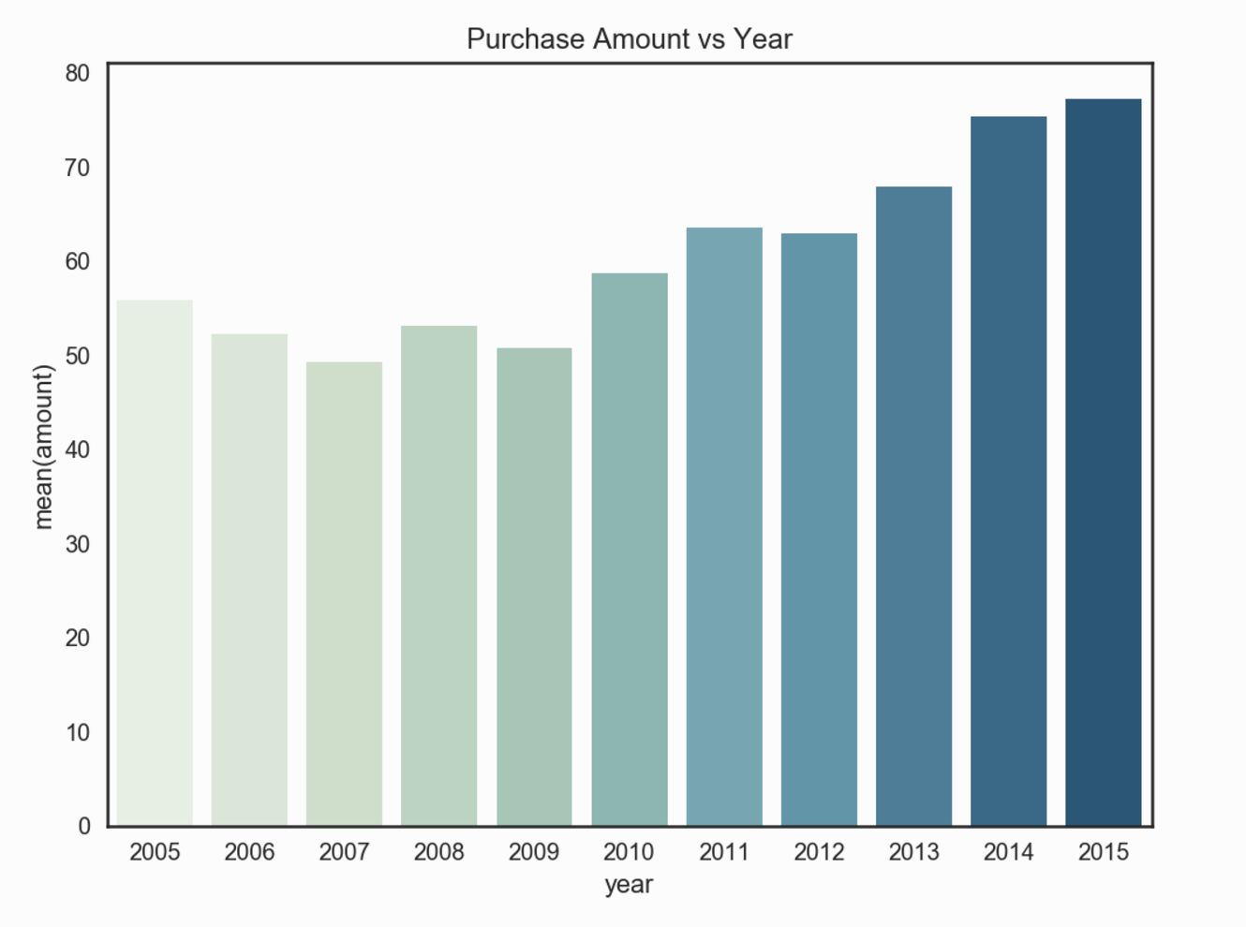
Previous purchase data
Goal — model & predict behavior:
Identify customers we should target for marketing
Predict how many existing customers will purchase our new phone
Project future sales based on a model that looks at probabilities relating to customer past purchases
Notes:
We examined Pear purchase data over the last 10 years from 2005 to 2015, each year includes a new phone release
We used this data to model and predict customer behavior. Our main goal is to determine which customer we should target for marketing, predict how many existing customers are going to purchase the new uPhone and project future 2016 sales based on a model that looks at the probability a customer purchases the new uPhone in 2016 based on when their last purchase was made using a 1 year Markov State transition matrix
One idea we had to retain existing customers and increase loyalty to our flagship product, the uPhone, was to offer a 10% discount to each customer for an old phone trade-in

Slide 6
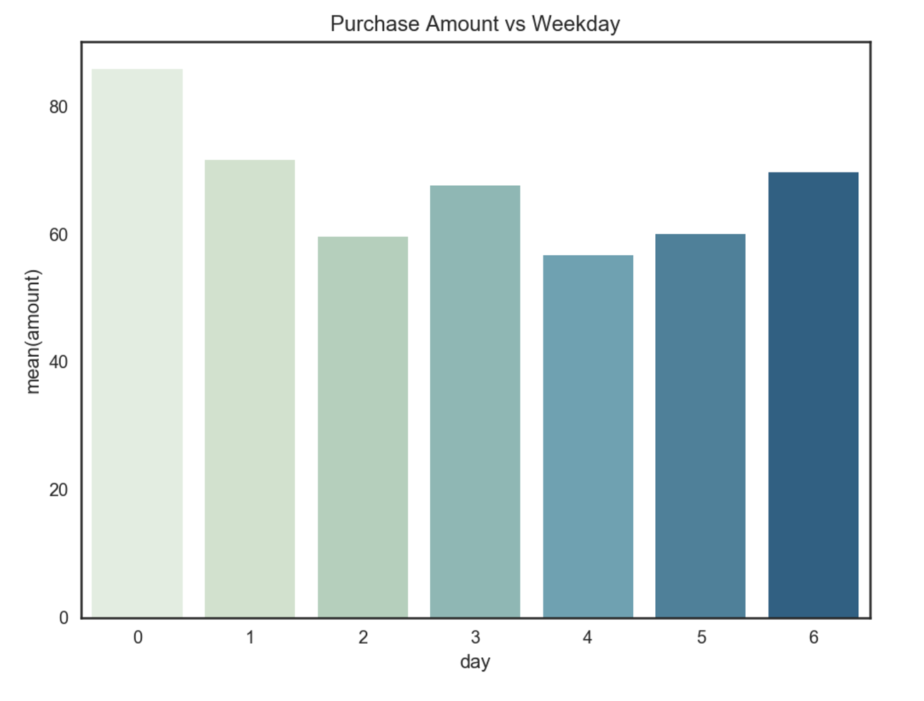
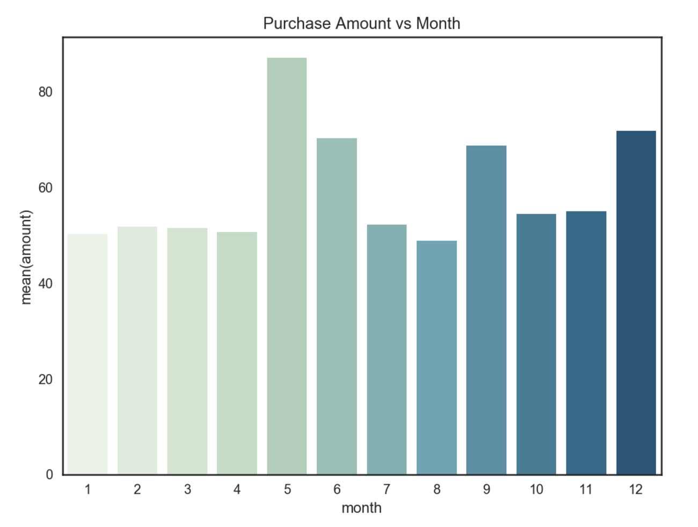
Previous purchase data
Notes:
As an aside we also examined past data to develop a product release strategy — as you can see the highest volume of purchases occur on Mondays and during May, June, September, and December.

Slide 7
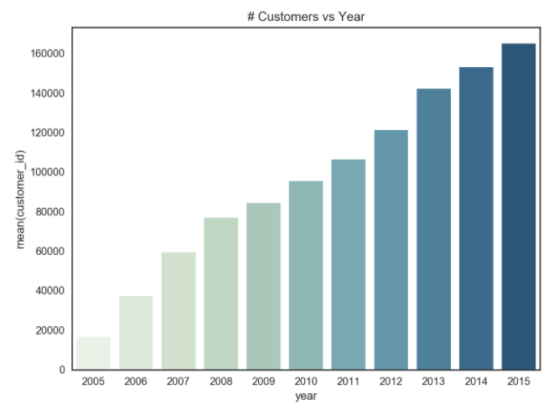
Customer Lifetime Value (CLV)
CLV is the economic value a customer brings over the course of their “lifetime” with a business
CLV not about a specific customer — but rather the customer base as a whole and an average typical customer lifetime
CLV important because helps identify most valuable customers
Notes:
CLV is not about any specific customer — it is about stepping back and taking a look at your customer base as a whole — understanding that while some never return and some never leave, on average there is a typical customer lifetime and that lifetime has a specific economic value.
CLV is als import to identified your most valuable group of customers, so you can focus on providing customer service tailored to their needs to ensure they stick around long-term.

Slide 8
Markov Chain
First segment customers into groups
Using these groups, we model the transition from one state (ie time since last purchase) to any other state using Markov chain
Transitions = probability of staying in one state or moving from one to another (dependent only on the previous state)
Probability = 0.3
Probability = 0.6
Customer purchases within
1 year
Customer purchases after
1 year
Probability = 0.7
Probability = 0.4
Notes:
The way we determine CLV is 2-fold:
First we segment our customers into groups based on purchases. JC will address this in more detail next. Using these groups we model the transition from one state (for example time since last purchase) to another state using a Markov chain.
In the Markov chain, these transitions give us the probability of staying in on state or moving from one state to any other state
It’s important to note, these probabilities are only dependent on the previous state and not the complete history of the data.

Slide 9



Customer Segmentation
Recency - When was the last purchase ?
Frequency - How many purchases ?
Monetary Value - What is the average purchase price ?

Slide 10
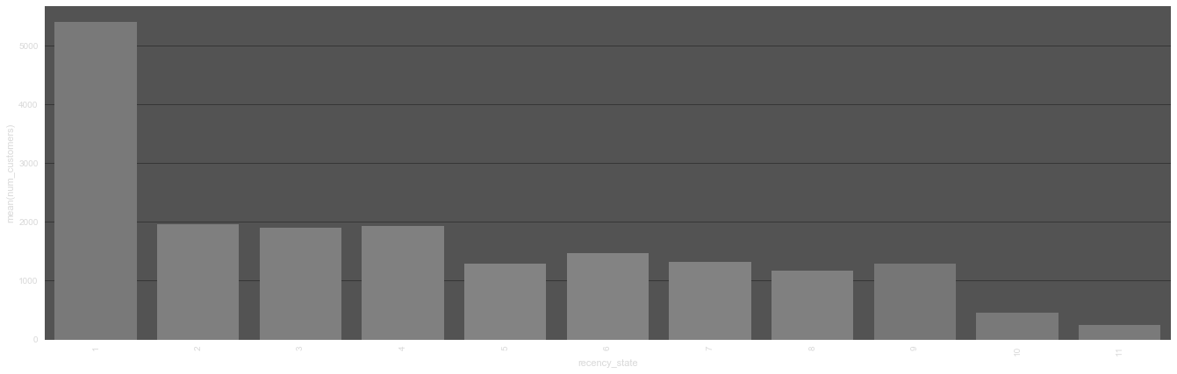
Recency Segmentation
States 1 : Last purchase in 2015
State 11 : Last purchase in 2005
~ 50% recently loyal customers
Let’s get that higher with uPhone 10

Slide 11
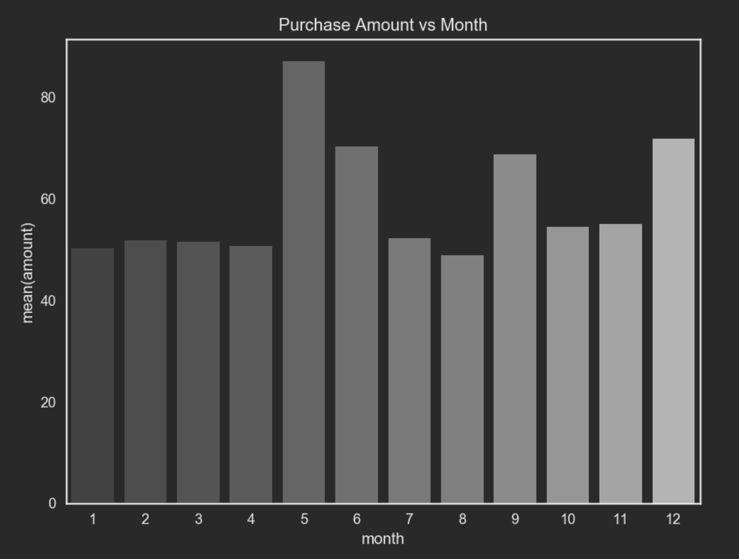
Recency Highlights
Last novelty effect : Open Source App Store
Currently - Product Launches in January
Peak Sales-May, June, September, December
Hypothesis - Holiday Sales
New Strategies :
Educate customer about our new products
Early Launch events
Pre-order increases recency sales
Maybe limited early product launches

Slide 12
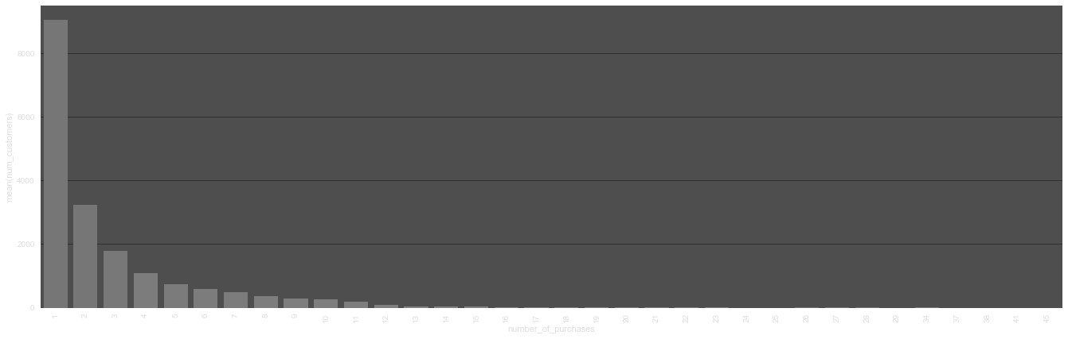
Frequency Segmentation
States 1 : 1 purchase
State n : n purchases
~ 70% customers with 1 purchase
Focus on customers returning
Incentivize sale of new models
E.g. exchange discounts

Slide 13
Frequency Highlights
Most customers have made 1 purchase
Increase focus and strategies on returning customers
Strategies :
Share copyright technology between Pear Products
Offer incentives for exchange of old products

Slide 14
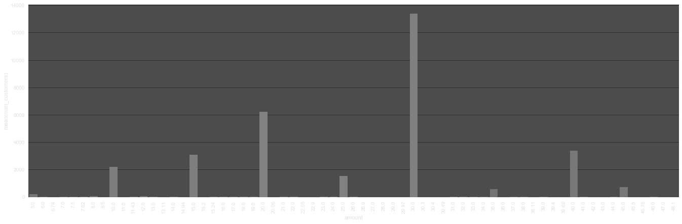
Monetary Segmentation
Low-price products ~$30 popular
Maintain offerings in low price segments
Make mid-price products more lucrative
E.g. accessorize mid-price products with low-price products

Slide 15
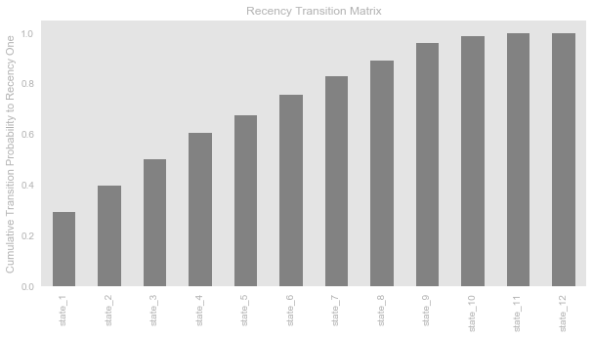




4 RFM Buckets for our Customers
RFM-recency 1
RFM-recency 2
RFM-recency 3
RFM-Inactive
●Last 10 years of customer purchase data
●States 7-12 have ~20% of transitioning to recency 1

Slide 16
Another Question

Slide 17
Cow Version
Cow Level in Diablo II

Slide 18
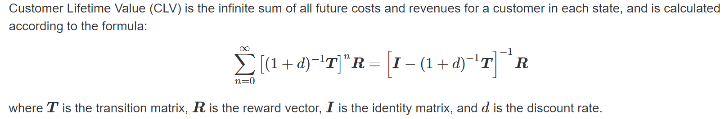
CLV Calculation

Slide 19
$20,000
Projected revenue per customer over the next 10 years
$10 marketing cost, .1 discount rate

Slide 20
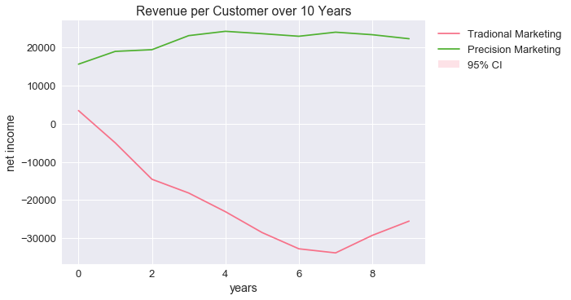
Revenue Projection

Slide 21
$25,000
Projected revenue per customer over the next 10 years
$10 marketing cost, .1 discount rate

Slide 22
One more thing...

